Slide 1

Slightly “re-factoring” the developers’ code after a code review… (HT Ryan Rinehart)
http://dbareactions.com/post/116730663535/slightly-re-factoring-the-developers-code-after

Slide 2

When the stored procedure submitted by a senior developer is rejected because it contains an unnecessary cursor, then it is resubmitted with the cursor replaced by a WHILE loop. (HT @JustMike)
http://dbareactions.com/post/115879949418/when-the-stored-procedure-submitted-by-a-senior

Slide 3

When the developer says, “I use stored procedures so I’m not vulnerable to SQL injection”
http://dbareactions.com/post/116235868534/when-the-developer-says-i-use-stored-procedures

Slide 4
How to think in SQL, a set-based mindset
Optimize
Organize
Index
Prioritize
Innovate
Notes:
Rows of monitors fading into the background
(Intermediate)
To reproduce the shape effects on this slide, do the following:
On the Home tab, in the Slides group, click Layout, and then click Blank.
On the Home tab, in the Drawing group, click Shapes, and then under Basic Shapes click Rounded Rectangle (second option from the left). On the slide, drag to draw a rectangle.
Drag the yellow diamond adjustment handle to the left to decrease the amount of rounding on the corners of the rectangle.
Select the rectangle. Under Drawing Tools, on the Format tab, in the Size group, do the following:
In the Shape Height box, enter 1.38”.
In the Shape Width box, enter 1.75”.
Also under Drawing Tools, on the Format tab, in the Shape Styles group, click the Format Shape dialog box launcher. In the Format Shape dialog box, click Fill in the left pane, select Solid fill in the Fill pane, and then do the following:
Click the button next to Color, click More Colors, and then in the Colors dialog box, on the Custom tab, enter values for Red: 54, Green: 65, Blue: 118.
In the Transparency box, enter 45%.
Also in the Format Shape dialog box, click Line Color in the left pane, and then in the Line Color pane select No line.
Also in the Format Shape dialog box, click 3-D Format in the left pane. In the 3-D Format pane, under Bevel, click the button next to Top, and then under Bevel click Relaxed Inset (first row, second option from the left). Next to Top, in the Width box, enter 6 pt, and in the Height box, enter 6 pt.
Also in the Format Shape dialog box, click Reflection in the left pane. In the Reflection pane, click the button next to Presets, and then under Reflection Variations click Tight Reflection, touching (first row, first option from the left).
On the Home tab, in the Clipboard group, click the arrow under Paste, and then click Duplicate. Repeat this process to create a total of five rectangles.
On the Home tab, in the Drawing group, click Arrange, point to Align, and then do the following:
Click Align to Slide.
Click Align Middle.
Click Distribute Horizontally.
On the Home tab, in the Drawing group, click Arrange, and then click Group.
Select the group. On the Home tab, in the bottom right corner of the Drawing group, click the Format Shape dialog box launcher. In the Format Shape dialog box, click 3-D Rotation in the left pane. In the 3-D Rotation pane, click the button next to Presets, and then under Perspective, click Perspective Below (first row, fourth option from the left).
Select the group. On the Home tab, in the Clipboard group, click the arrow to the right of Copy, and then click Duplicate. On the slide, drag the second group above the first group.
Under Drawing Tools, on the Format tab, in the bottom right corner of the Size group, click the Size and Position dialog box launcher. In the Format Shape dialog box, click Size in the left pane. In the Size pane, under Scale, do the following:
Select Lock aspect ratio.
In the Height box, enter 85%.
Also in the Format Shape dialog box, click Fill in the left pane. In the Fill pane, select Solid fill, and then in the Transparency box, enter 55%.
Select the second group. On the Home tab, in the Clipboard group, click the arrow to the right of Copy, and then click Duplicate. On the slide, drag the third group above the second group.
Under Drawing Tools, on the Format tab, in the bottom right corner of the Size group, click the Size and Position dialog box launcher. In the Format Shape dialog box, click Size in the left pane. In the Size pane, under Scale, do the following:
Select Lock aspect ratio.
In the Height box, enter 85%.
On the Home tab, in the bottom right corner of the Drawing group, click the Format Shape dialog box launcher. In the Format Shape dialog box, click Fill in the left pane. In the Fill pane, select Solid fill, and then in the Transparency box, enter 65%.
Select the third group. On the Home tab, in the Clipboard group, click the arrow to the right of Copy, and then click Duplicate. On the slide, drag the fourth group above the third group.
Under Drawing Tools, on the Format tab, in the bottom right corner of the Size group, click the Size and Position dialog box launcher. In the Format Shape dialog box, click Size in the left pane. In the Size pane, under Scale, do the following:
Select Lock aspect ratio.
In the Height box, enter 85%.
Also in the Format Shape dialog box, click Fill in the left pane. In the Fill pane, select Solid fill, and then in the Transparency box, enter 75%.
Select the fourth group. On the Home tab, in the Clipboard group, click the arrow to the right of Copy, and then click Duplicate. On the slide, drag the fifth group above the fourth group.
Under Drawing Tools, on the Format tab, in the bottom right corner of the Size group, click the Size and Position dialog box launcher. In the Format Shape dialog box, click Size in the left pane. In the Size pane, under Scale, do the following:
Select Lock aspect ratio.
In the Height box, enter 85%.
Also in the Format Shape dialog box, click Fill in the left pane. In the Fill pane, select Solid fill, and then in the Transparency box, enter 85%.
Select the fifth group. On the Home tab, in the Clipboard group, click the arrow to the right of Copy, and then click Duplicate. On the slide, drag the sixth group above the fifth group.
Under Drawing Tools, on the Format tab, in the bottom right corner of the Size group, click the Size and Position dialog box launcher. In the Format Shape dialog box, click Size in the left pane. In the Size pane, under Scale, do the following:
Select Lock aspect ratio.
In the Height box, enter 85%.
Also in the Format Shape dialog box, click Fill in the left pane. In the Fill pane, select Solid fill, and then in the Transparency box, enter 95%.
Using the ruler as a guide, drag the groups into rows on the slide so that the top and bottom margins are approximately 1.75”. On the View tab, in the Show/Hide group, clear Ruler.
Press CTRL-A to select all of the groups. On the Home tab, in the Drawing group, click Arrange, point to Align, and then do the following:
Click Align Selected Objects.
Click Distribute Vertically.
Click Align to Slide.
Click Align Center.
On the Home tab, in the Drawing group, click Arrange, and then click Group.
On the Home tab, in the Drawing group, click Arrange, point to Align, and then do the following:
Point to Align, and then click Align to Slide.
Point to Align, and then click Align Middle.
Point to Align, and then click Align Center.
To reproduce the background effects on this slide, do the following:
On the Design tab, in the Background group, click Background Styles, and then click Format Background. In the Format Background dialog box, click Fill in the left pane, select Gradient fill in the Fill pane, and then do the following:
In the Type list, select Radial.
Click the button next to Direction, and then click From Center (third option from the left).
Under Gradient stops, click Add gradient stops or Remove gradient stops until three stops appear in the slider.
Also under Gradient stops, customize the gradient stops as follows:
Select the first stop in the slider, and then do the following:
In the Position box, enter 33%.
Click the button next to Color, and then under Theme Colors click White, Background 1 (first row, first option from the left).
In the Transparency box, enter 0%.
Select the next stop in the slider, and then do the following:
In the Position box, enter 67%.
Click the button next to Color, click More Colors, and then in the Colors dialog box, on the Custom tab, enter values for Red: 228, Green: 233, Blue: 236.
In the Transparency box, enter 0%.
Select the last stop in the slider, and then do the following:
In the Position box, enter 100%.
Click the button next to Color, click More Colors, and then in the Colors dialog box, on the Custom tab, enter values for Red: 178, Green: 186, Blue: 210.
In the Transparency box, enter 0%.

Slide 5
Kevin Devine
Former Database Administrator
Current Software Engineer
MRI Software, LLC
@kdevine7800
kdevine@yahoo.com

Slide 6


Slide 7


Slide 8
Steps to Thinking in SQL
In “Inside Microsoft SQL Server 2005: T-SQL Programming”, Itzik Ben-Gan describes the path a SQL developer takes…

Slide 9
Steps to Thinking in SQL
Procedural – It is common to see cursors, temporary tables, dynamic execution, and procedural coding. Programmers are usually oblivious to the damage they are causing

Slide 10
Steps to Thinking in SQL
Becoming sober – Programmers tend to believe “experts” who say cursors, temporary tables and dynamic execution are evil and should never be used. There’s usually a lack of confidence at this stage.

Slide 11
Steps to Thinking in SQL
Maturity – This is the Zen mindset. They feel confident about their code. Programmers develop intuition regarding the type of solution that would fit the task.

Slide 12
SQL expects “What do you want?” not “How do I get?” statements Looping is NOT a SQL concept SQL terminology Results-oriented thinking

Slide 13
SQL expects “What do you want?” not “How do I get?” statements
Finding all customers that are in the state of Ohio
Procedural:
Regular Expressions
Iterate each line with an IndexOf
Shove into a DataTable object and query
LINQ Query (Select Many)
SQL:
SELECT * FROM Customers WHERE State = ‘OH’

Slide 14
Looping is NOT a SQL concept
RBAR – Row By Agonizing Row
Cursors are curses
While loops take a while (and are WORSE than Cursors)
Functions cause non-SARG
SARG – Search ARGuments

Slide 15

Looping…
This example was a trigger…
By born1945 (Flickr) [CC BY 2.0 (http://creativecommons.org/licenses/by/2.0) or Public domain], via Wikimedia Commons

Slide 16
Looping…
This example was in a trigger…

Slide 17
Looping…
CREATE TRIGGER Sales.TR_SpecialOfferIn ON Sales.SpecialOffer FOR INSERT AS
SET NOCOUNT ON;
BEGIN
DECLARE OfferCursor CURSOR FOR SELECT i.description , i.DiscountPct , i.type , i.Category , i.StartDate , i.EndDate , i.MinQty , i.MaxQty FROM inserted AS i;
DECLARE @Description AS nvarchar( 510 ) , @DiscountPct AS smallmoney , @Type AS nvarchar( 100 ) , @Category AS nvarchar( 100 ) , @StartDate AS datetime , @EndDate AS datetime , @MinQty AS int , @MaxQty AS int , @nCount AS int , @sPrtMsg AS nvarchar( 1024 );
OPEN OfferCursor;
FETCH NEXT FROM OfferCursor INTO @Description , @DiscountPct , @Type , @Category , @StartDate , @EndDate , @MinQty , @MaxQty;
WHILE @@fetch_status = 0
BEGIN
IF @Type = 'No Discount' BEGIN GOTO SkipOffers END;
IF @Type = 'New Product BEGIN GOTO SkipOffers END;
SELECT @nCount = 0;
SELECT @nCount = COUNT(*) FROM Sales.SpecialOffer WHERE Category = @Category AND DiscountPct = @DiscountPct AND Type = @Type AND (StartDate >= @StartDate AND EndDate <= @EndDate OR EndDate >= @StartDate AND StartDate < @EndDate) HAVING COUNT( * ) > 1;
IF @nCount > 1
BEGIN
SELECT @sPrtMsg = ' There is another Special Offer record in effect for ' + RTRIM( @Category ) + ' ' + RTRIM( @Type ) + ' ' + RTRIM( CONVERT( char , @StartDate , 1 )) + '-' + RTRIM( CONVERT( char , @EndDate , 1 )) + ' ' + @DiscountPct + ' Discount ';
RAISERROR( @sPrtMsg , 16 , 1 );
ROLLBACK TRANSACTION;
GOTO SkipOffers;
END;
SkipOffers:
FETCH NEXT FROM OfferCursor INTO @Description , @DiscountPct , @Type , @Category , @StartDate , @EndDate , @MinQty , @MaxQty;
END;
CLOSE OfferCursor;
DEALLOCATE OfferCursor;
END;

Slide 18
Looping…
…
DECLARE OfferCursor CURSOR FOR SELECT i.description , i.DiscountPct , i.type , i.Category , i.StartDate , i.EndDate , i.MinQty , i.MaxQty FROM inserted AS i;
…

Slide 19
Looping…
…
SELECT @nCount = COUNT(*) FROM Sales.SpecialOffer WHERE Category = @Category AND DiscountPct = @DiscountPct AND Type = @Type AND (StartDate >= @StartDate AND EndDate <= @EndDate OR EndDate >= @StartDate AND StartDate < @EndDate) HAVING COUNT( * ) > 1;
IF @nCount > 1
BEGIN
SELECT @sPrtMsg = ' There is another Special Offer record in effect for ' + RTRIM( @Category ) + ' ' + RTRIM( @Type ) + ' ' + RTRIM( CONVERT( char , @StartDate , 1 )) + '-' + RTRIM( CONVERT( char , @EndDate , 1 )) + ' ' + @DiscountPct + ' Discount ';
…

Slide 20
Non-Looping
CREATE TRIGGER Sales.TR_SpecialOfferIn ON Sales.SpecialOffer FOR INSERT, UPDATE
AS BEGIN
DECLARE @continue int, @nCount int, @sPrtMsg nvarchar(1024)
SELECT @continue = count(1) from inserted WHERE Type not in ('No Discount','New Product')
IF @continue > 0 BEGIN
SELECT @nCount = COUNT(*), @sPrtMsg = ' There is another Special Offer record in effect for ' + RTRIM( i.Category ) + ' ' + RTRIM( i.Type ) + ' ' + RTRIM( CONVERT( char , i.StartDate , 1 )) + '-' + RTRIM( CONVERT( char , i.EndDate , 1 )) + ' ' + i.DiscountPct + ' Discount‘ FROM Sales.SpecialOffer r inner join inserted i ON r.Category = i.Category AND r.Type = i.Type AND r.DiscountPct = i.DiscountPct AND i.Type NOT IN ('No Discount','New Product') AND ((r.StartDate >= i.StartDate AND r.EndDate <= i.EndDate) OR (r.EndDate >= i.EndDate AND r.StartDate <= i.StartDate)) group by i.Category,i.Type,i.StartDate,i.EndDate,i.DiscountPct HAVING COUNT(*) > 1;
IF @nCount > 1 BEGIN
RAISERROR( @sPrtMsg , 16 , 1 );
ROLLBACK TRANSACTION;
END;END;END;

Slide 21
Before After
CREATE TRIGGER Sales.TR_SpecialOfferIn ON Sales.SpecialOffer FOR INSERT AS
SET NOCOUNT ON;
BEGIN
DECLARE OfferCursor CURSOR FOR SELECT i.description , i.DiscountPct , i.type , i.Category , i.StartDate , i.EndDate , i.MinQty , i.MaxQty FROM inserted AS i;
DECLARE @Description AS nvarchar( 510 ) , @DiscountPct AS smallmoney , @Type AS nvarchar( 100 ) , @Category AS nvarchar( 100 ) , @StartDate AS datetime , @EndDate AS datetime , @MinQty AS int , @MaxQty AS int , @nCount AS int , @sPrtMsg AS nvarchar( 1024 );
OPEN OfferCursor;
FETCH NEXT FROM OfferCursor INTO @Description , @DiscountPct , @Type , @Category , @StartDate , @EndDate , @MinQty , @MaxQty;
WHILE @@fetch_status = 0
BEGIN
IF @Type = 'No Discount' BEGIN GOTO SkipOffers END;
IF @Type = 'New Product BEGIN GOTO SkipOffers END;
SELECT @nCount = 0;
SELECT @nCount = COUNT(*) FROM Sales.SpecialOffer WHERE Category = @Category AND DiscountPct = @DiscountPct AND Type = @Type AND (StartDate >= @StartDate AND EndDate <= @EndDate OR EndDate >= @StartDate AND StartDate < @EndDate) HAVING COUNT( * ) > 1;
IF @nCount > 1
BEGIN
SELECT @sPrtMsg = ' There is another Special Offer record in effect for ' + RTRIM( @Category ) + ' ' + RTRIM( @Type ) + ' ' + RTRIM( CONVERT( char , @StartDate , 1 )) + '-' + RTRIM( CONVERT( char , @EndDate , 1 )) + ' ' + @DiscountPct + ' Discount ';
RAISERROR( @sPrtMsg , 16 , 1 );
ROLLBACK TRANSACTION;
GOTO SkipOffers;
END;
SkipOffers:
FETCH NEXT FROM OfferCursor INTO @Description , @DiscountPct , @Type , @Category , @StartDate , @EndDate , @MinQty , @MaxQty;
END;
CLOSE OfferCursor;
DEALLOCATE OfferCursor;
END;
CREATE TRIGGER Sales.TR_SpecialOfferIn ON Sales.SpecialOffer FOR INSERT, UPDATE
AS BEGIN
DECLARE @continue int, @nCount int, @sPrtMsg nvarchar(1024)
SELECT @continue = count(1) from inserted WHERE Type not in ('No Discount','New Product')
IF @continue > 0 BEGIN
SELECT @nCount = COUNT(*), @sPrtMsg = ' There is another Special Offer record in effect for ' + RTRIM( i.Category ) + ' ' + RTRIM( i.Type ) + ' ' + RTRIM( CONVERT( char , i.StartDate , 1 )) + '-' + RTRIM( CONVERT( char , i.EndDate , 1 )) + ' ' + i.DiscountPct + ' Discount‘ FROM Sales.SpecialOffer r inner join inserted i ON r.Category = i.Category AND r.Type = i.Type AND r.DiscountPct = i.DiscountPct AND i.Type NOT IN ('No Discount','New Product') AND ((r.StartDate >= i.StartDate AND r.EndDate <= i.EndDate) OR (r.EndDate >= i.EndDate AND r.StartDate <= i.StartDate)) group by i.Category,i.Type,i.StartDate,i.EndDate,i.DiscountPct HAVING COUNT(*) > 1;
IF @nCount > 1 BEGIN
RAISERROR( @sPrtMsg , 16 , 1 );
ROLLBACK TRANSACTION;
END;END;END;

Slide 22
Cursors
Sometimes they are required
If declared properly, they are better than WHILE loops
DECLARE Cursor CURSOR STATIC FORWARD_ONLY

Slide 23
Cursors
Sometimes they are required
If declared properly, they are better than WHILE loops
DECLARE Cursor CURSOR FAST_FORWARD

Slide 24
Looping is NOT a SQL concept
RBAR – Row By Agonizing Row
Cursors are curses
While loops take a while (and are WORSE than Cursors)
Functions cause non-SARG
SARG – Search ARGuments

Slide 25

Why is SARG important?
Allows indexes to work
Picks the best plan
Easiest way to fix poor performance

Slide 26
What is wrong here?
SELECT SalesOrderID
FROM Sales.SalesOrderHeader
WHERE CAST( CONVERT( char( 8 ) , ISNULL( shipdate , orderdate ) , 112 ) AS datetime ) BETWEEN '2011-06-24' AND '2011-06-25'
ORDER BY SalesOrderID;

Slide 27
What is wrong here?
SELECT SalesOrderID
FROM Sales.SalesOrderHeader
WHERE CAST( CONVERT( char( 8 ) , ISNULL( shipdate , orderdate ) , 112 ) AS datetime ) BETWEEN '2011-06-24' AND '2011-06-25'
ORDER BY SalesOrderID;

Slide 28
Demo – Show, don’t just Tell
SELECT SalesOrderID
FROM Sales.SalesOrderHeader
WHERE ShipDate BETWEEN '2011-06-24' AND '2011-06-25'
OR ShipDate IS NULL
AND OrderDate BETWEEN '2011-06-24' AND '2011-06-25'
ORDER BY SalesOrderID;

Slide 29
Demo – Show, don’t just Tell

Slide 30
SQL Terminology
Index
Clustered Index Seek
Clustered Index Scan
Index Scan
Index Seek
Key Lookup
Table Scan ☹
Notes:
What is good, what is bad?

Slide 31
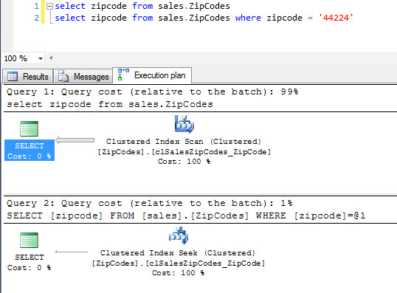
SQL Terminology
Index
Clustered Index Seek/Scan
Notes:
What is good, what is bad?

Slide 32
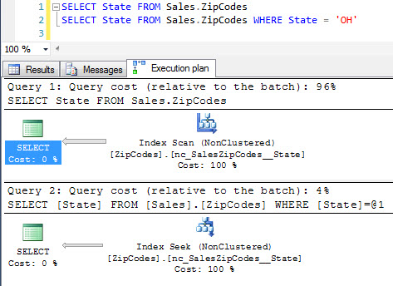
SQL Terminology
Index
Index Seek/Scan
Notes:
What is good, what is bad?

Slide 33
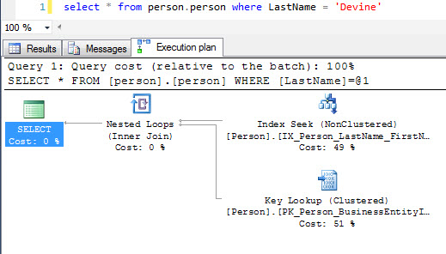
SQL Terminology
Index
Key Lookup
Notes:
What is good, what is bad?

Slide 34
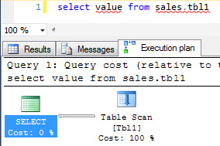
SQL Terminology
Index
Table Scan ☹
Notes:
This means you don’t have a clustered index. ALWAYS have a clustered index.

Slide 35
SQL Terminology
Joins
INNER JOINS
LEFT AND RIGHT OUTER JOINS
MERGE JOIN
HASH MATCH
NESTED LOOPS JOIN
ANTI/SEMI JOIN (LEFT / RIGHT / INNER)
Notes:
Divide into one for each category and describe the good and bad.
What is beneficial?

Slide 36
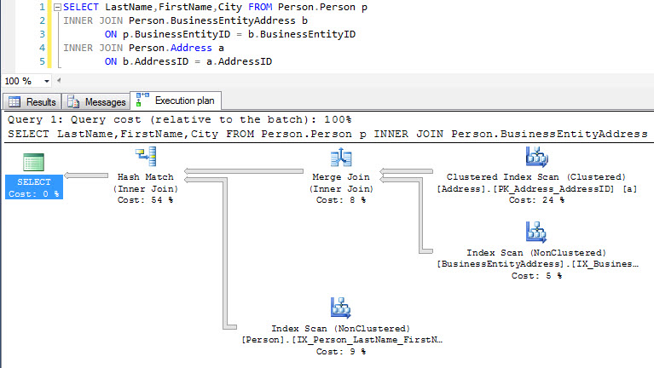
SQL Terminology
Joins
INNER JOINS
Notes:
Divide into one for each category and describe the good and bad.
What is beneficial?

Slide 37
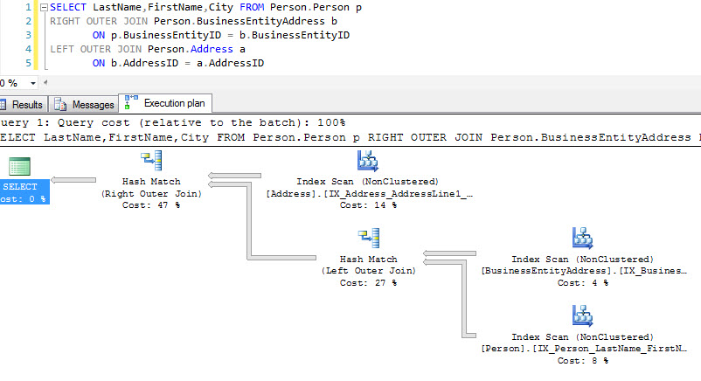
SQL Terminology
Joins
LEFT OUTER / RIGHT OUTER JOINS
Notes:
Divide into one for each category and describe the good and bad.
What is beneficial?

Slide 38
SQL Terminology
Joins
MERGE JOIN
Notes:
Merge Join is probably the best join. This joins two sorted data
As said before, the Sort Merge Join has two parts. The first part is the Sort which can be quite expensive. However, if the data is sorted already, the second part which is handled by the Merge Join operator has the following properties:
+ There is no setup cost.
+ It does not require memory.
+ The first rows are returned immediately, as soon as a match is found.
- At least one column in the join condition needs to use an equality comparison.
- If there is a many to many relationship in the data, a tempdb work table is created and used to provide a rewind-ability of the data potentially hurting performance severely.
The equality comparison is required to be able to sort both inputs the same way. However, there is a special case. SQL Server can use the Merge Join operator when a nonequi full outer join is required. In that case the entire first input is copied into the work table. Then a nested loops algorithm is executed between the second input and the work table. Each row in the worktable that had a match is marked. In the end an additional scan of the worktable returns all non-matched rows. This is a very expensive process hidden under a seemingly fast operator. Be aware of this.
sets.

Slide 39
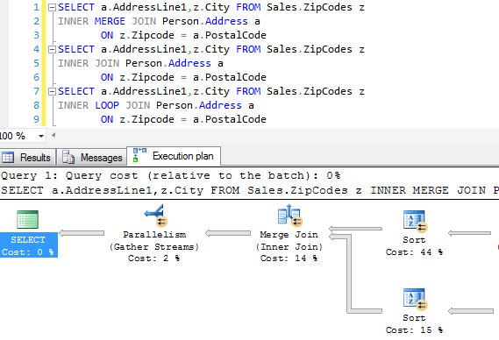
SQL Terminology
Joins
SORT - MERGE JOIN
Notes:
Merge Join is probably the best join. This joins two sorted data
As said before, the Sort Merge Join has two parts. The first part is the Sort which can be quite expensive. However, if the data is sorted already, the second part which is handled by the Merge Join operator has the following properties:
+ There is no setup cost.
+ It does not require memory.
+ The first rows are returned immediately, as soon as a match is found.
- At least one column in the join condition needs to use an equality comparison.
- If there is a many to many relationship in the data, a tempdb work table is created and used to provide a rewind-ability of the data potentially hurting performance severely.
The equality comparison is required to be able to sort both inputs the same way. However, there is a special case. SQL Server can use the Merge Join operator when a nonequi full outer join is required. In that case the entire first input is copied into the work table. Then a nested loops algorithm is executed between the second input and the work table. Each row in the worktable that had a match is marked. In the end an additional scan of the worktable returns all non-matched rows. This is a very expensive process hidden under a seemingly fast operator. Be aware of this.
sets.

Slide 40
SQL Terminology
Joins
HASH MATCH
Notes:
Hash match creates a hash of the top dataset and then iterates through the bottom to match them with the top.
Because the Hash Join like the Sort Merge Join has a setup phase, there is a setup cost involved. This setup cost is due to the creation of the in-memory hash table. While that process is not complicated, it will take time and a lot of memory. Below are the characteristics of the Hash Join algorithm.
+ All logical join types can be handled.
- There is a substantial setup cost.
- It does require a sizable amount of memory, big enough to fit the entire left side input. (Spilling to tempdb is possible)
- During the entire time it takes to create the hash index, no row will be returned.
- At least one column in the join condition needs to use an equality comparison.
All over all this is the most resource intensive join algorithm because of the expensive build phase. However, once the hash table is build, this join algorithm can be quite fast. For large tables with no usable index, the time savings during the probe phase will more than outweigh the additional cost of the build phase. Keep in mind however that because of the large memory requirements, only very few of these can run at the same time.

Slide 41
SQL Terminology
Joins
Nested Loops
Notes:
What is good, what is bad?

Slide 42
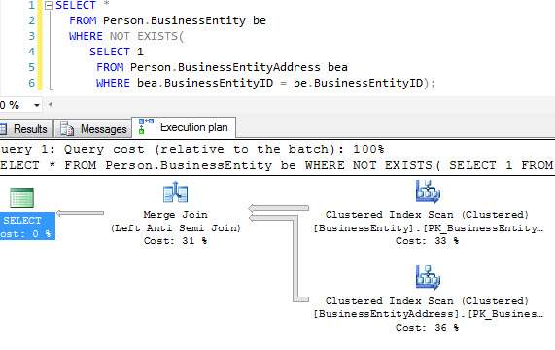
SQL Terminology
Joins
Anti/Semi Left/Right Joins
Notes:
What is good, what is bad?

Slide 43
Demo – Show, don’t just Tell

Slide 44
SQL Terminology
Plans
Rows (Estimated vs Actual)
I/O Cost
CPU Cost
Executions
Operator Cost
Row Size
Data Size
Ordered
Index
Output List
Where
Notes:
What is good, what is bad?

Slide 45
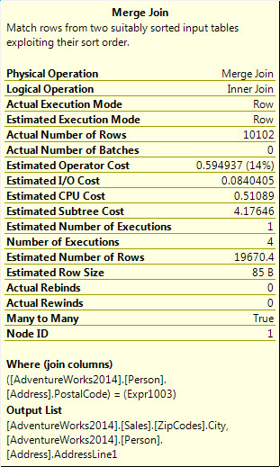
SQL Terminology
Plans
Notes:
What is good, what is bad?

Slide 46
SQL Terminology
Plans
Notes:
What is good, what is bad?

Slide 47
SQL Terminology
Plans
Notes:
What is good, what is bad?

Slide 48
SQL Terminology
Plans
Notes:
Represents the amount of time that the optimizer thinks this operator will take. It’s a cumulative cost associated with the whole subtree up to the node.

Slide 49
SQL Terminology
Plans
Notes:
Represents the amount of time that the optimizer thinks this operator will take. It’s a cumulative cost associated with the whole subtree up to the node.

Slide 50
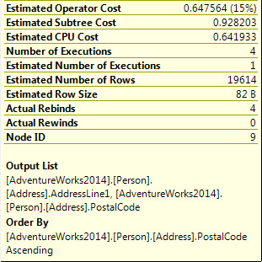
SQL Terminology
Plans
Notes:
Represents the amount of time that the optimizer thinks this operator will take. It’s a cumulative cost associated with the whole subtree up to the node.

Slide 51
SQL Terminology
Plans
Notes:
Represents the amount of time that the optimizer thinks this operator will take. It’s a cumulative cost associated with the whole subtree up to the node.

Slide 52
SQL Terminology
Plans
Notes:
Represents the amount of time that the optimizer thinks this operator will take. It’s a cumulative cost associated with the whole subtree up to the node.

Slide 53
How to think about SQL?
Results-Oriented Thinking
Process-Oriented Thinking
How can I achieve this?
What do I have to do now to get there?
See the end in your mind and look for the fastest way to get there
Base decisions on the results of an action
What does this task mean?
What will happen on the way to get there?
What is the best way to do something?
Results should not determine future decisions

Slide 54
Is this bad?
SELECT LocationName FROM Locations WHERE
dbo.fnDistanceCalculator(Locations.Zipcode, @zipcode) < 10
ORDER BY dbo.fnDistanceCalculator(Locations.Zipcode,@zipcode)

Slide 55
Is this bad?
SELECT LocationName FROM Locations WHERE
dbo.fnDistanceCalculator(Locations.Zipcode, @zipcode) < 10
ORDER BY dbo.fnDistanceCalculator(Locations.Zipcode,@zipcode)
Should you fix this?

Slide 56
Is this bad?
SELECT TOP 10 LocationName FROM Locations WHERE
dbo.fnDistanceCalculator(Locations.Zipcode, @zipcode) < 10 ORDER BY dbo.fnDistanceCalculator(Locations.Zipcode,@zipcode)
Should you fix this?
SELECT LocationName, dbo.fnDistanceCalculator(Locations.Zipcode,@zipcode) as distance
INTO #distances FROM Locations
SELECT TOP 10 LocationName FROM #distances ORDER BY distance
Maybe…

Slide 57
Is this bad?
SELECT TOP 10 LocationName FROM Locations ORDER BY dbo.fnDistanceCalculator(Locations.Zipcode,@zipcode)
Should you fix this?
DECLARE @zipcode char(5) = '44224'
DECLARE @source geography
SELECT @source = GeoLocation FROM Sales.ZipCodes WHERE zipcode = @zipcode
SELECT s.[Name],@source.STDistance(SpatialLocation) as distance INTO #distance FROM [Sales].[Store] s INNER JOIN Person.BusinessEntityAddress bea ON s.BusinessEntityID = bea.BusinessEntityID INNER JOIN Person.Address a ON bea.AddressID = a.AddressID INNER JOIN Person.StateProvince sp ON a.StateProvinceID = sp.StateProvinceID INNER JOIN Person.CountryRegion cr ON sp.CountryRegionCode = cr.CountryRegionCode WHERE sp.CountryRegionCode = 'US'
SELECT TOP 10 Name FROM #distance ORDER BY distance

Slide 58
SQL expects “What do you want?” not “How do I get?” statements Looping is NOT a SQL concept SQL terminology Results-oriented thinking

Slide 59
Q&A
Kevin Devine
MRI Software, LLC
@kdevine7800
kdevine@yahoo.com
Great SQL resources:
Sqlsentry.com (Plan Explorer)
Apexsql.com (ApexRefactor)
Twitter hashtag: #sqlhelp
Brentozar.com
Sqlskills.com
Blog.SqlAuthority.com
MSSQLTips.com

